Slide 1

Chapter 11
JSON

Slide 2
Content
What is JSON?
Syntax JSON
Example JSON
JSON in Python
From JSON to a Python dictionary
From JSON file to a Python dictionary

Slide 3
What is JSON?
JSON = JavaScript Object Notation
Pronounced like the first name ‘Jason’
Language-independent and lightweight data format for data exchange between servers and (web) applications
Derived from JavaScript
Used for storing and transporting data
Designed to be ‘human-readable’
File format: .json

Slide 4
Syntax JSON
JSON is made up by key-value pairs
A key is always a string, enclosed by double quotes
A semicolon (:) seperates the key and value
A value must be one of the following data types:
A string
A number
An object
An array
A boolean
null
Pay attention: string values must be enclosed by double quotes
{
"course":"API Development"
}
{
"key":value
}

Slide 5
Syntax JSON
A JSON file usually contains multiple key-value pairs
Seperated by a comma
No comma after the last key-value pair
The order of key-value pairs doesn’t matter
For JSON, both objects/files at the side of this slide contain the same data
A key can only occur once within an object, but can occur again in child objects
{
"course":"API Development",
"semester":1
}
{
"course":"API Development",
"semester":1
}
{
"course":"API Development",
"course":"Python“
}

Slide 6
Syntax JSON
Notation of data types:
A string
A number
An object
An array
A boolean
null
{
"string":"a string value",
"wholeNumber":17,
"decimalNumber":7.37,
"object":{
"course":"API Development",
"hoursPerWeek":3
},
"array":[
{"name":"Els Depaepe", "class":"2 CCS 01"},
{"name":"Simon Vervoort", "class":"2 CCS 02"},
{"name":"Bram Verbiest","class":"2 IOT"}
],
"boolean":true,
"empty":null
}

Slide 7
Example JSON
Example 1: from table to JSON
Table: result
{
"results":[
{
"course":"Python",
"student":"Laurien Stas",
"grade":12
},
{
"course":"SQL",
"student":"Robbe Van Amont",
"grade":4
},
{
"course":"Python",
"student":"Michaël Aerts",
"grade":14
}
]
}
course | student | grade
Python | Laurien Stas | 12
SQL | Robbe Van Amont | 4
Python | Michaël Aerts | 14

Slide 8
Example JSON
{
"courses":[
{
"courseId":1,
"name":"Python",
"semester":1,
"results":[
{"resultId":1,"student":"Laurien Stas",
"grade":12},
{"resultId":3,"student":"Michaël Aerts",
"grade":14}
]
},
{
"courseId":2,
"name":"SQL",
"semester":2,
"results":[
{"resultId":2, "student":"Robbe Van Amont", "grade":4 }
]
}
]
}
Example 2: nested structure
Table: course
Table: result
courseId | name | semester
1 | Python | 1
2 | SQL | 2
resultId | courseId | student | grade
1 | 1 | Laurien Stas | 12
2 | 2 | Robbe Van Amont | 4
3 | 1 | Michaël Aerts | 14

Slide 9
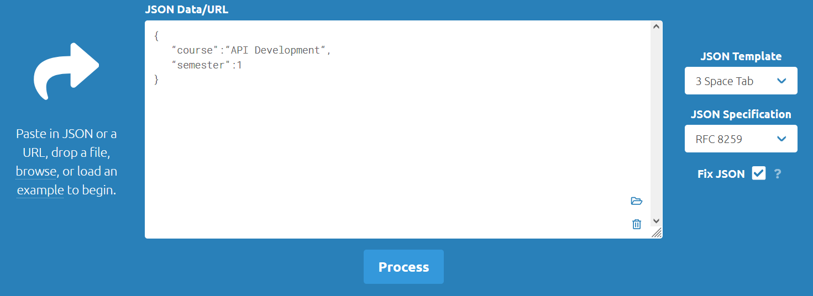
Structure JSON
The structure of JSON should always be correct, otherwise it can not be parsed
Check whether the structure is correct or not: https://jsonformatter.curiousconcept.com/
Enter your JSON and click on ‘Process’

Slide 10
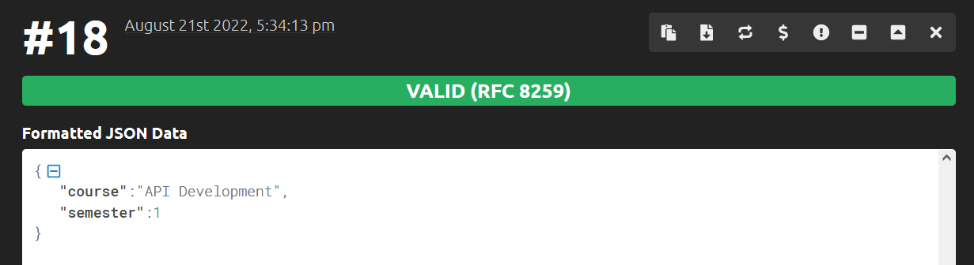
Structure JSON
Scroll down and check the validity

Slide 11
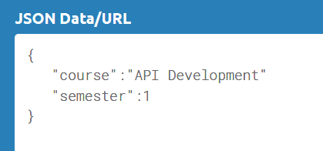
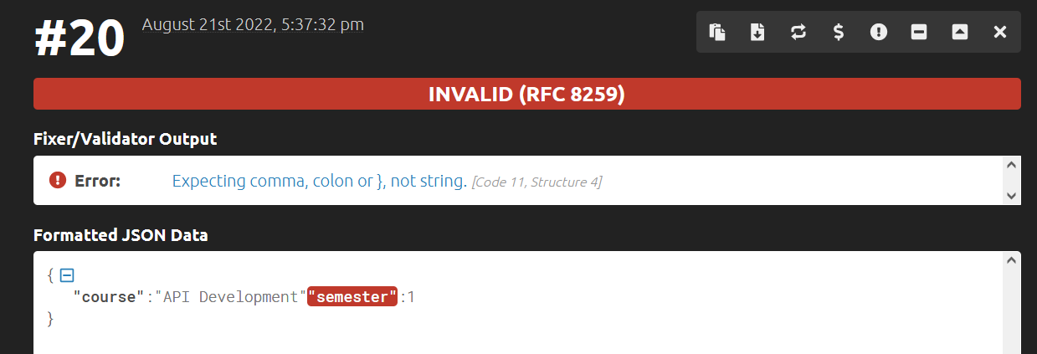
Structure JSON
Made a mistake? Check the error message(s)!

Slide 12
Exercise
Exercise: convert the following table data into JSON
Table: song
name | artist | durationInSeconds | hasAlbum
Something | Lasgo | 221 | true
Phoenix | Enemy Inside | 208 | true
Expectations | Lauren Jauregui | 204 | false

Slide 13
JSON in Python
Python has a build in package to work with JSON data
To use it, import the ‘json’ package: import json
The structure of JSON is very similar to a dictionary in Python

Slide 14
JSON in Python: loads()
json.loads()
Function that can be used to parse a valid JSON string and convert it into a Python dictionary
Expects a string value as parameter, not a file
Useful if you already have a JSON object in Python

Slide 15

From JSON to Python dictionary
From JSON to Python dictionary
import json # a JSON course object, put in a Python variable: json_course = '{"name":"API Development","semester":1}' # parse the JSON object using the loads() function: course = json.loads(json_course) # print the data: print("Course name:", course["name"]) print("Semester:", course["semester"])

Slide 16
JSON in Python: load()
json.load()
Function that can be used to parse the data from a .json file to a JSON object
Then converts the JSON object into a Python dictionary
Expects a file location as parameter

Slide 17
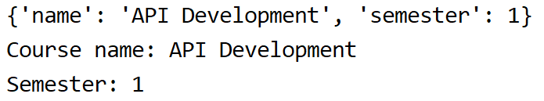
From JSON file to Python dictionary
From JSON file to Python dictionary
import json with open("course.json") as json_file: # read out the file and parse the JSON object using the load() function: course = json.load(json_file) print(course) # print the data: print("Course name:", course["name"]) print("Semester:", course["semester"])

Slide 18
JSON in Python: dumps()
json.dumps()
Function that can be used to convert a Python dictionary (or other object) into a JSON string
Expects a dictionary or other Python object as parameter

Slide 19
From Python dictionary to JSON
From Python dictionary to JSON
import json # a Python dictionary: course = {'name': 'API Development', 'semester': 1} # convert into JSON using the dumps function: json_course = json.dumps(course) # the result is a JSON string: print(json_course)

Slide 20
JSON in Python: dump()
json.dump()
Function that can be used to write data of a Python dictionary to a .json file
Writes in the memory and then the command for writing to disk is executed separately
Expects 2 parameters: first the Python dictionary, then the file to write to
Pay attention:
The file should be opened before the json.dump() function is called
The file should be closed after calling the json.dump() function

Slide 21

From Python dictionary to JSON file
From Python dictionary to JSON
import json # a Python dictionary: course = {'name': 'API Development', 'semester': 1} with open("course.json", "w", encoding="UTF-8") as file: json.dump(course, file)

Slide 22
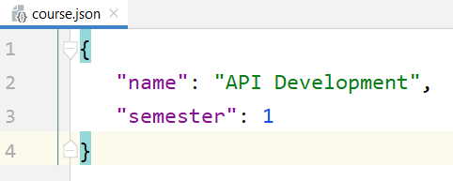
JSON in Python
A big advantage of JSON is readability
By default, Python generates one line in a .json file
Solution to make it even more readable:
add indents
import json # a Python dictionary: course = {'name': 'API Development', 'semester': 1} with open("course.json", "w", encoding="UTF-8") as file: json.dump(course, file, indent=3)

